Slide 1
Text Editing, Zip Archives, and Privileged Execution

Slide 2
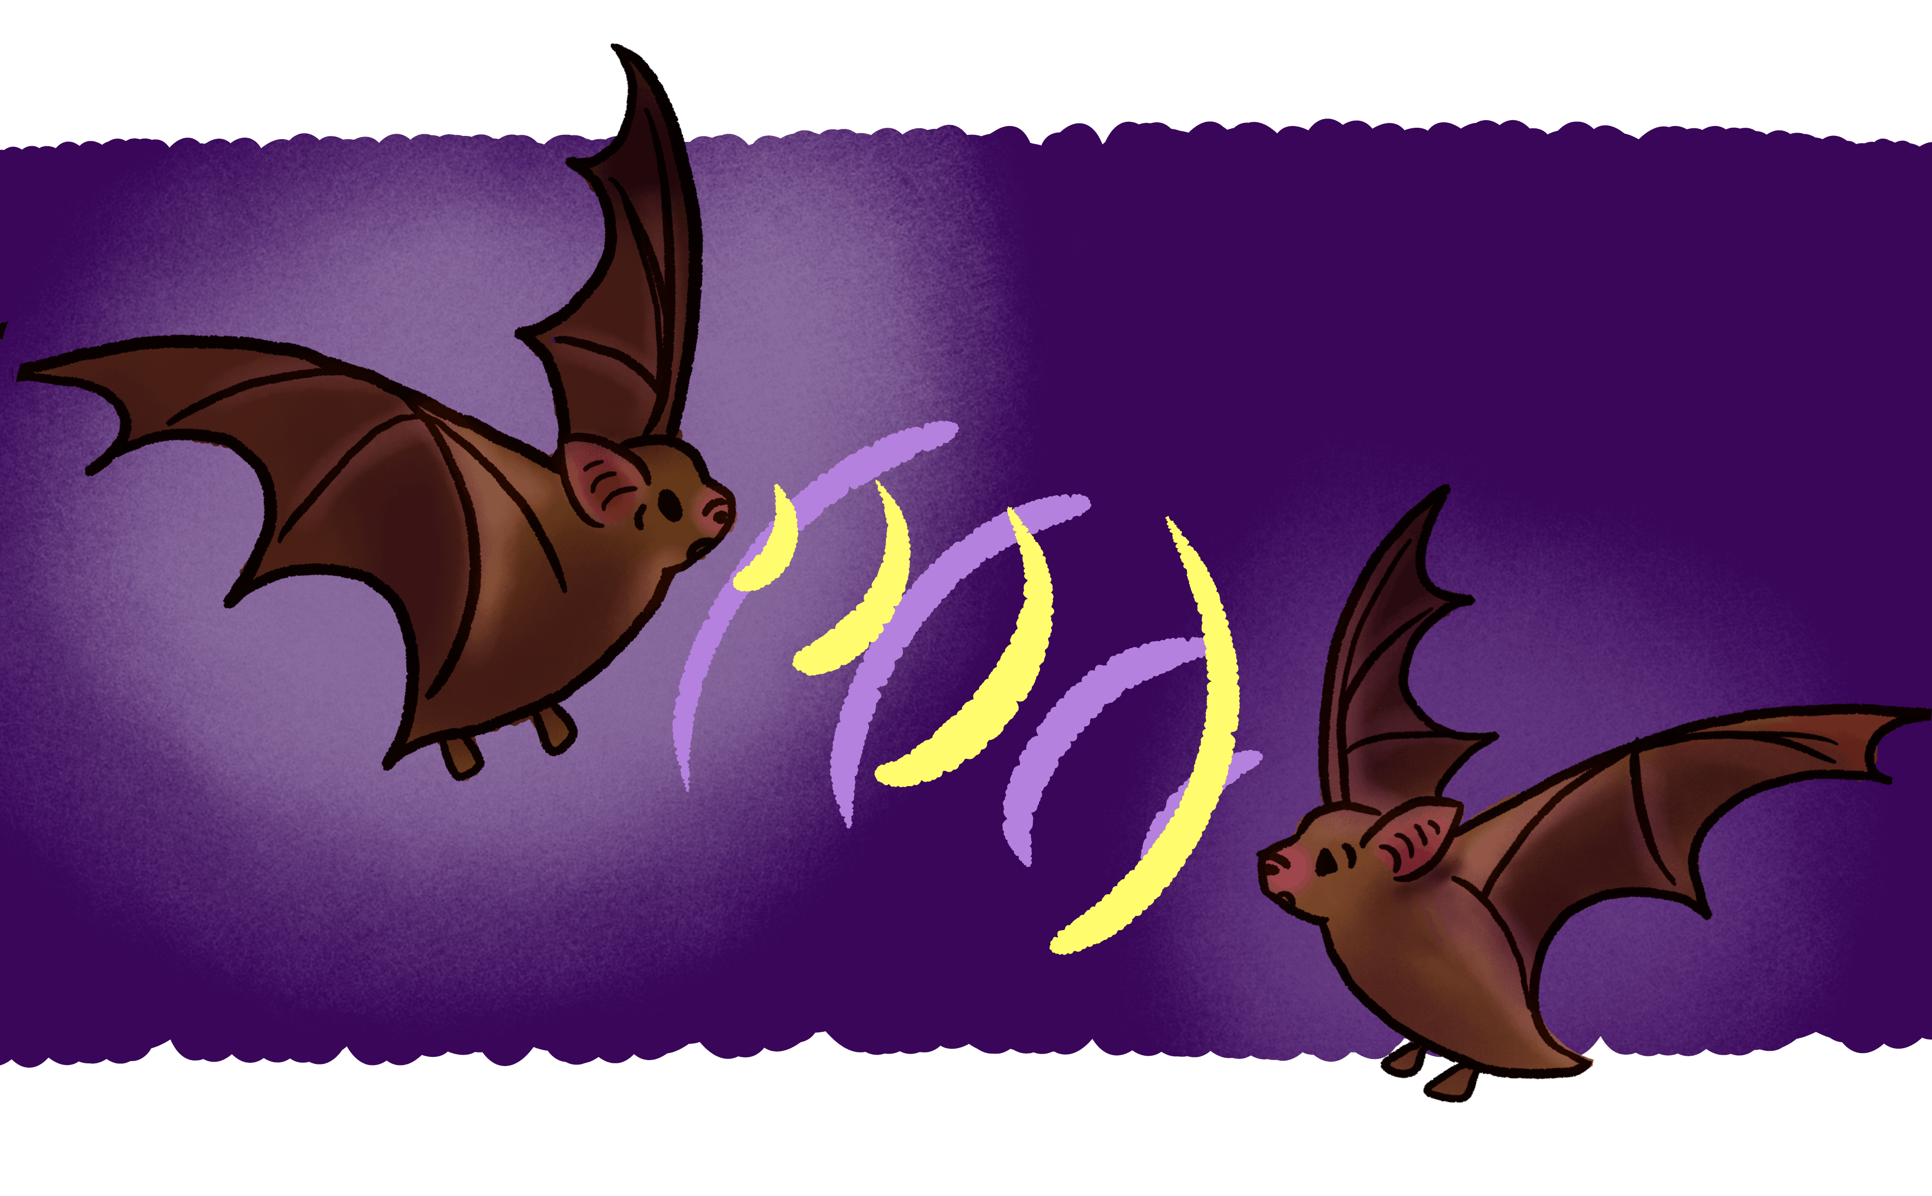
Hello… Hello… Hello… Hello...
Echo is a surprisingly useful command
It takes string input and well echos it to STDOUT
Why may this be useful?
https://thevarsity.ca/2018/01/22/blind-as-a-bat/

Slide 3

Nano
Very small, tiny…
Like Ant-Man
Okay, fine
It’s a lightweight command line text editor
Also, my personal preferred command line editor

Slide 4

Vim
How do I exit Vim?!?!?!
You will not be the first to wonder
Vim is an improved version of vi which is the default text editor in Unix
It’s very powerful, but can have
a bit of a learning curve.

Slide 5

File
Shows us what kind of file we are dealing.
Useful since MOST of the time Linux doesn’t care about file extensions

Slide 6
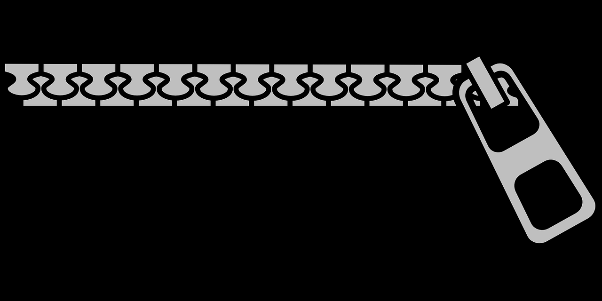
Zip files and Archiving Utilities
Zip Technical Specification
Zip – Zips a file using pkzip specifications
Unzip – I’ll let y’all guess what this does…
Gzip – Compresses files using Lempel-Ziv
Gunzip – think about it…
Tar – an old Unix archival program that Zip is analogous to

Slide 7
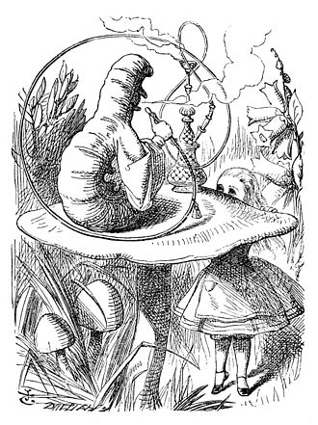
Who am I?
“Who are YOU? said the Caterpillar.” ~Lewis Carroll (Alice's Adventures in Wonderland)
Whoami – Not all shells are as nice as the one we we’ve been using that displays our user right on the command line.
https://en.wikipedia.org/wiki/Caterpillar_(Alice's_Adventures_in_Wonderland)

Slide 8

Passwd
This file is located in the /etc/ directory
What kind of files are stored here?
What do you think you’ll see in this file?

Slide 9

So… Where ARE the passwords?
/etc/shadow
In the 90s these were the same file, but for security it was split off
Many programs need to know information about users, but they don’t need the password hashes
https://en.wikipedia.org/wiki/Shadow_the_Hedgehog

Slide 10

Who do? SUDO!
This is how we ask the Super User (root) to perform an action that our user doesn’t necessarily have permission to preform
su – this is how we switch users

Slide 11

Lab Time!
Work with your team to get through the lab exercises
Remember the point is not to complete the labs, but to understand why you were able to complete them

